Slide 1

CSC346-Computer Organization and assembly language Lab Lecture Semester-# Fall 2020
Prepared by:
Huma Chaudhry
M.Phil Computer Science

Slide 2
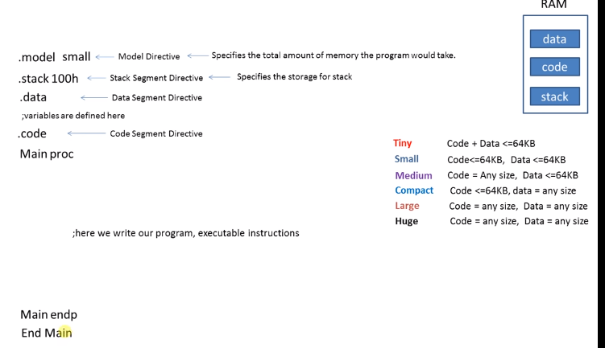
Assembly language syntax

Slide 3
Variable definition, initialization
. Data
syntax
Variablename datasize value
Value is initializer is value
Initializer directive is datasize
Variable name shouldn’t be the reserved words

Slide 4
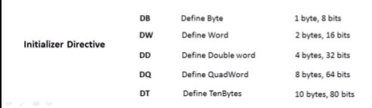

Slide 5
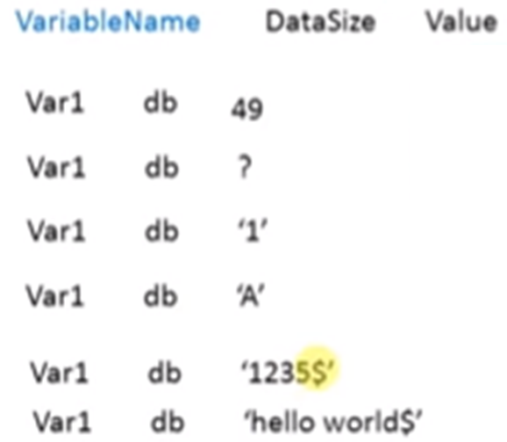
Format to initialize the variable
Asci code of the value
Syntax if you want to initialize the value in the code
Syntax to initialize the value to the variable
Syntax to initialize the alphabet to the variable
Syntax to initialize the number string
Syntax to initialize the string

Slide 6
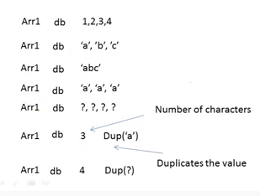
Format to initialize the array

Slide 7
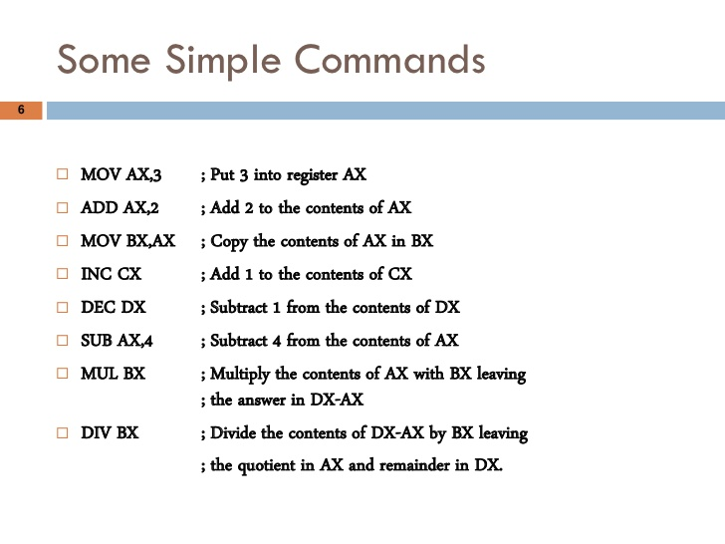

Slide 8
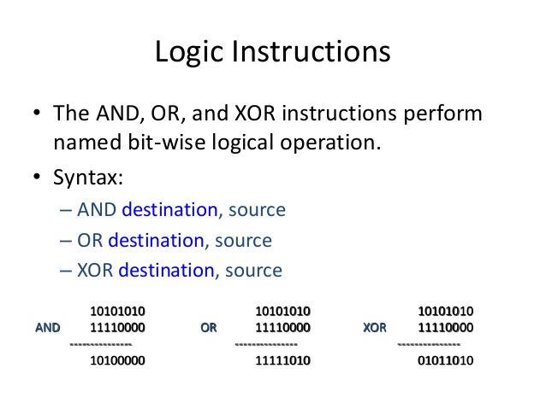

Slide 9
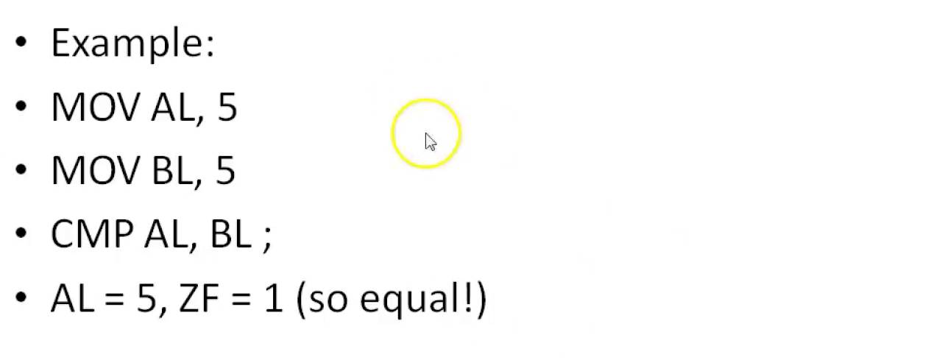
Compare Command

Slide 10
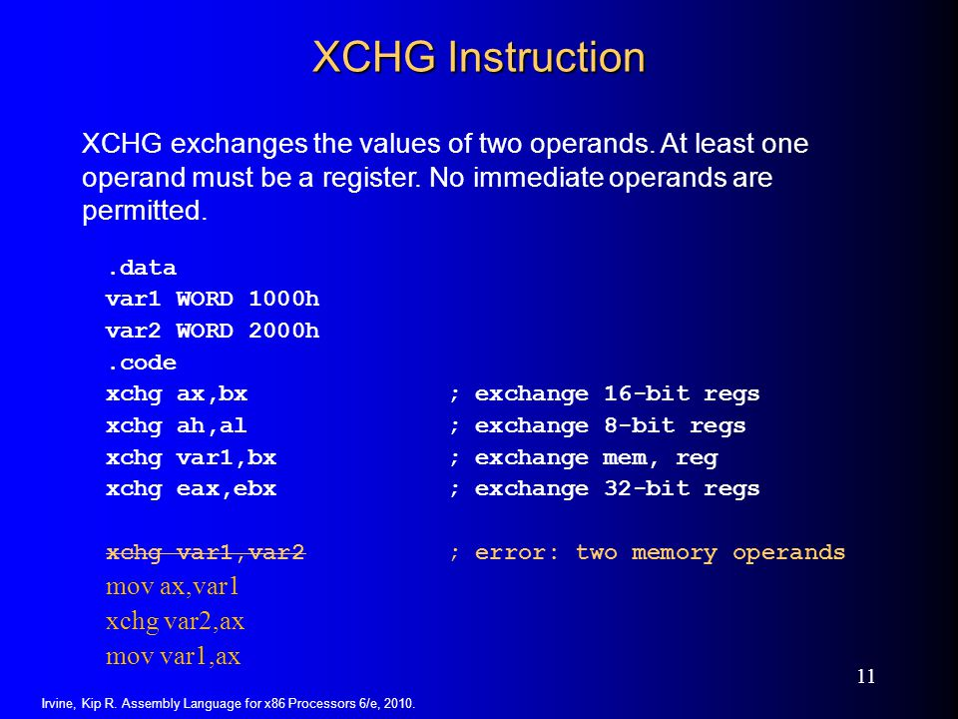

Slide 11
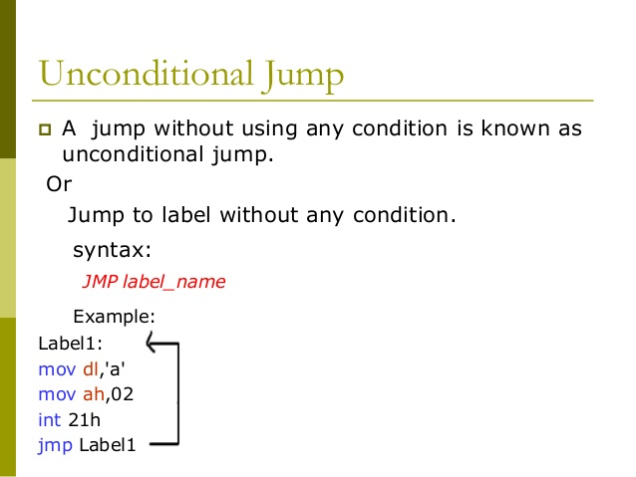
Unconditional jump

Slide 12
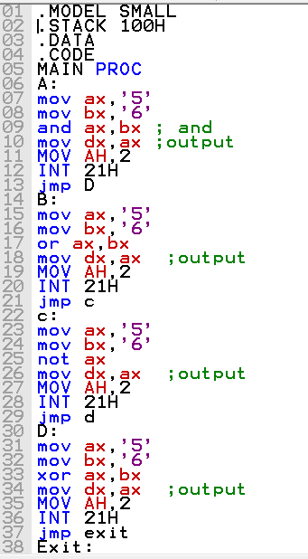
What will be the output of this program?

Slide 13
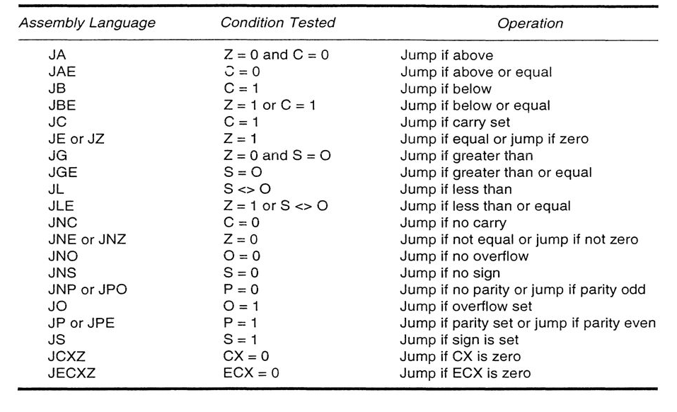
Conditional Jumps

Slide 14
Q & A

